Slide 1

Exploratory Data Analysis
G2M insight for Cab Investment Firm
Submitted by Chooladeva Piyasiri
21 February 2023

Slide 2
Agenda
Problem Statement
Datasets Exploration
EDA
Hypothesis Investigation
Summary & Recommendations

Slide 3
Problem Statement
XYZ is a private firm in US. Due to remarkable growth in the Cab Industry in last few years and multiple key players in the market, it is planning for an investment in Cab industry and as per their Go-to-Market(G2M) strategy they want to understand the market before taking final decision.
Their problem is their inability to identify the right company for making investment.

Slide 4
Datasets Exploration
Below are the list of datasets which are provided for the analysis:
Cab_Data.csv – this file includes details of transaction for 2 cab companies
Customer_ID.csv – this is a mapping table that contains a unique identifier which links the customer’s demographic details
Transaction_ID.csv – this is a mapping table that contains transaction to customer mapping and payment mode
City.csv – this file contains list of US cities, their population and number of cab users.
Timeframe of the data: 2016-01-01 to 2018-12-31

Slide 5

EDA

Slide 6
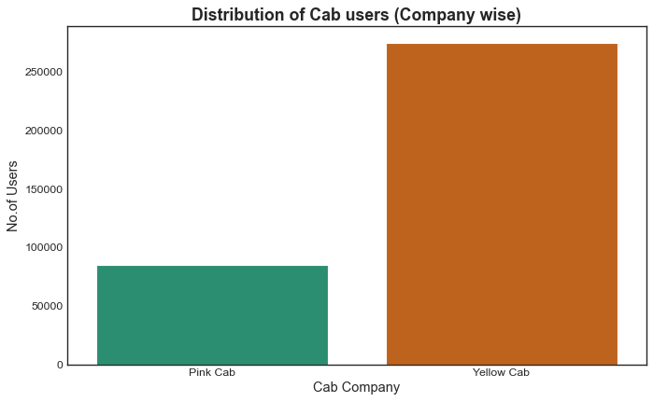
Figure 01: Distribution of Cab users (Company wise)
Users prefer to ride in the 'Yellow Cab' over the 'Pink Cab.'

Slide 7
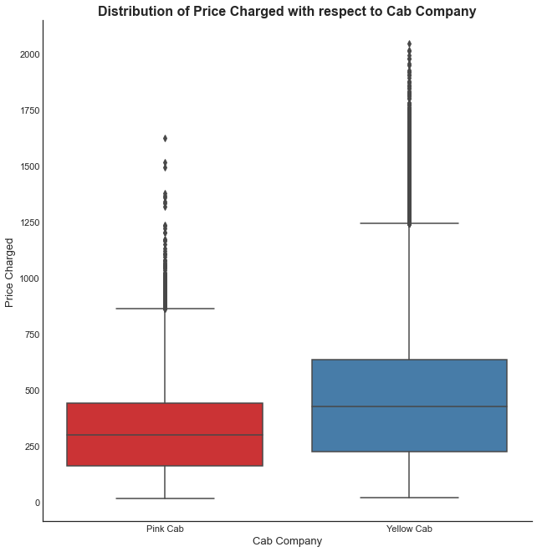
Figure 02: Distribution of Price Charged with respect to Cab Company
When compared to the 'Pink Cab,' the 'Yellow Cab' charges the most.
And also, the 'Yellow cab' has a bigger pricing range than the 'Pink cab’.
These outliers can be caused by the use of luxury cars, the weather, or the holiday season.

Slide 8
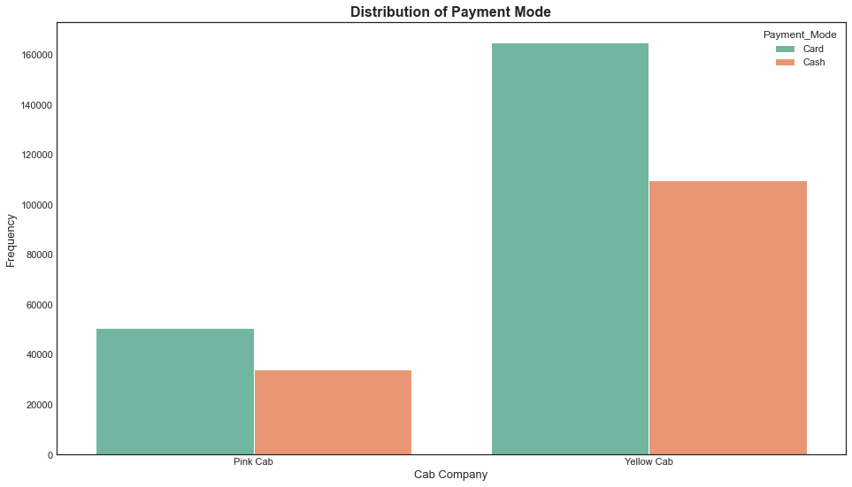
Figure 03: Distribution of Payment Mode
Users prefer to pay with their cards rather than cash.

Slide 9
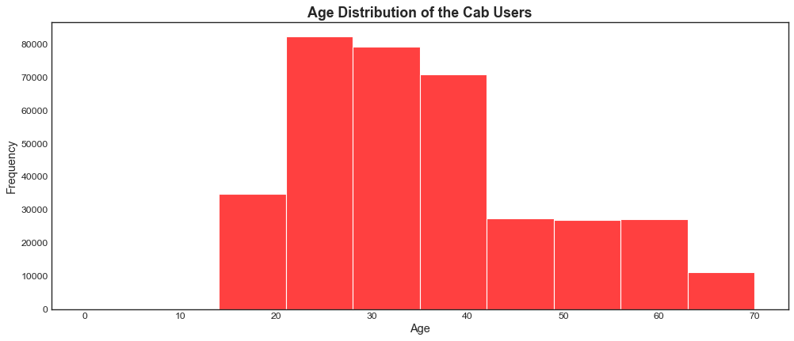
Figure 04: Age Distribution of the Cab Users
The majority of cab users are between the ages of 20 and 40.

Slide 10
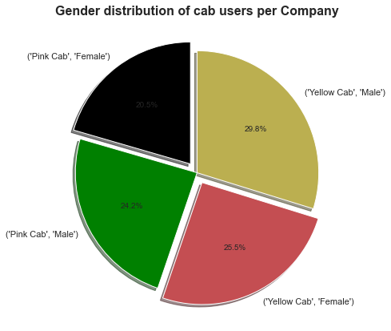
Figure 05: Gender distribution of unique cab users per Company
Males prefer cabs over females for both companies.

Slide 11
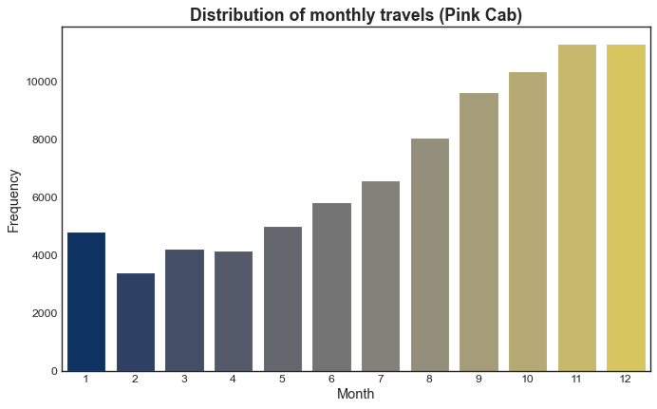
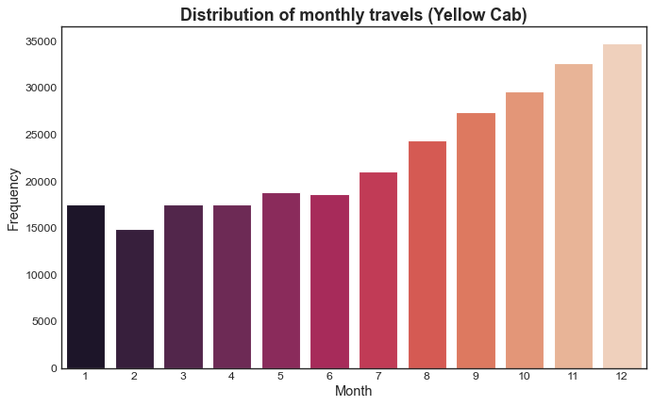
Figure 06: Seasonal distribution of User transactions
We can see a gradual increase in monthly travels for both cab companies beginning in the middle of the year and continuing until the end of the year.

Slide 12
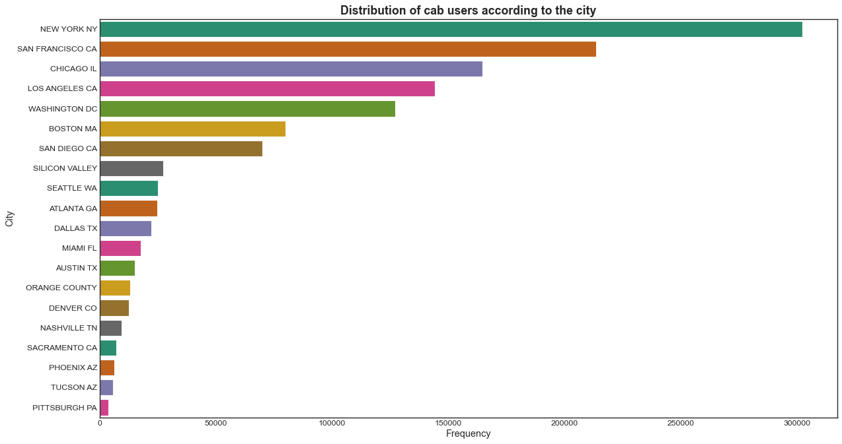
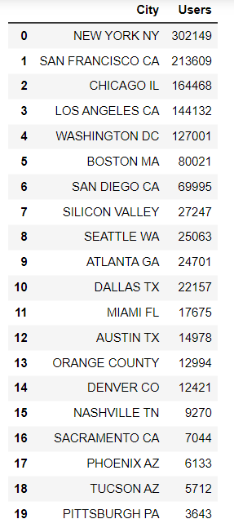
Figure 07: Distribution of cab users according to the city
New York has the most cab user transactions, followed by San Francisco, Chicago, and Los Angeles.

Slide 13
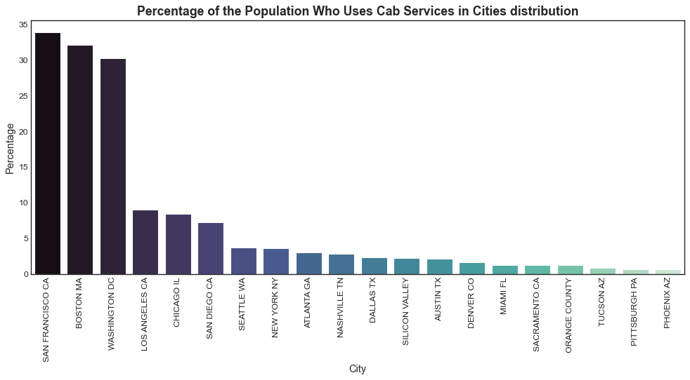
Figure 08: Percentage of the Population Who Uses Cab Services in Cities
In San Francisco, Washington, and Boston, cabs are used by more than 30% of the population.

Slide 14
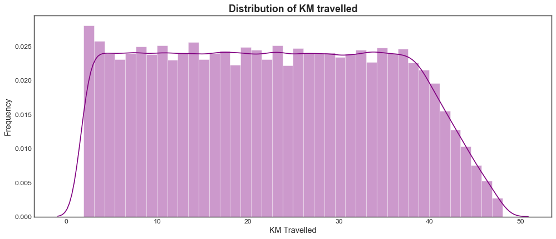
Figure 09: Distribution of KM travelled
We can see that the majority of the rides are between 2 and 48 kilometers long.

Slide 15
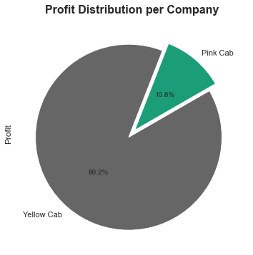
Figure 10: Profit Distribution per Company
The 'Yellow Cab' Company received 89.2% of the total profit.

Slide 16
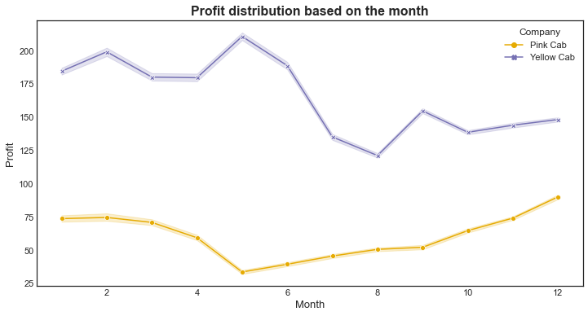
Figure 11: Profit distribution based on the month
The most profitable month for Pink Cabs is December, followed by November and January.
May is the most profitable month for Yellow Cab, followed by February and January.
When compared to other quarters, Yellow Cabs' profit drops significantly near the end of the year.

Slide 17
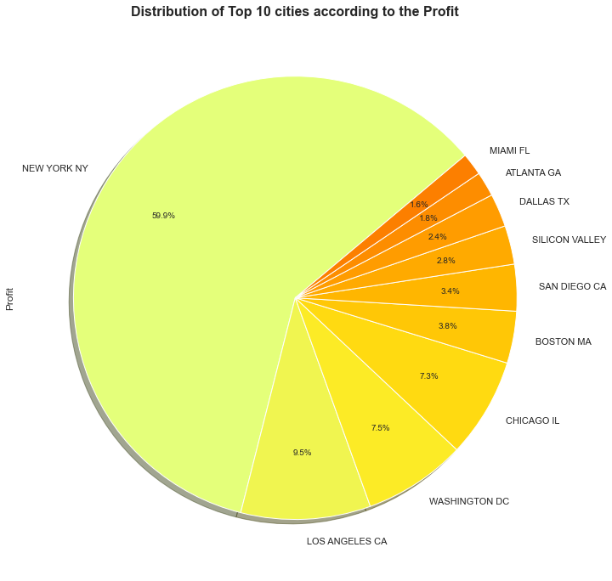
Figure 12: Distribution of Top 10 cities according to the Profit
New York City generates 60% of the profits for both companies and has the highest number of users.

Slide 18
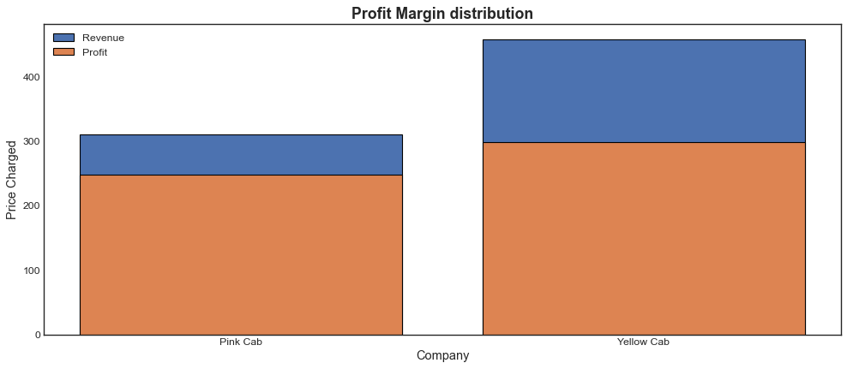
Figure 13: Profit Margin distribution
When compared to the Pink cab, the Yellow cab has a significantly higher profit margin.

Slide 19
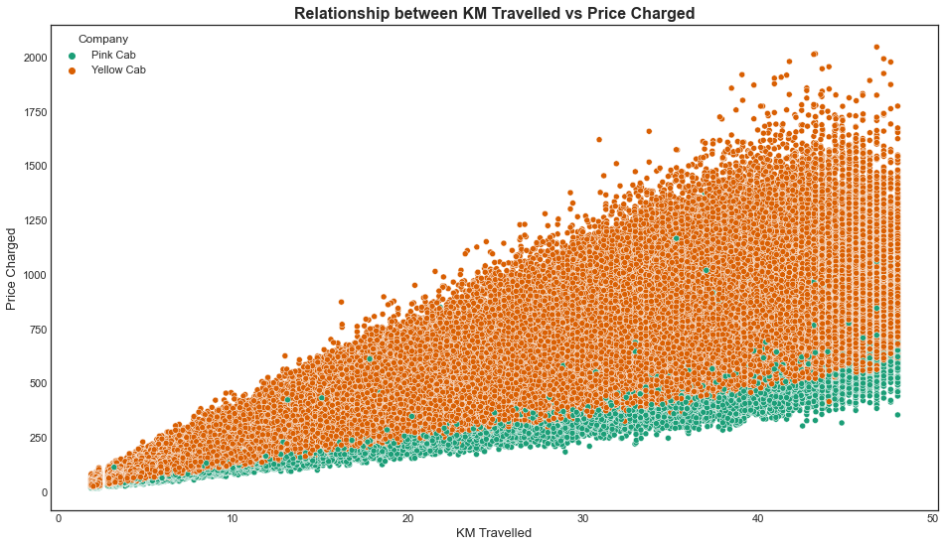
Figure 14: Relationship between KM Travelled vs Price Charged
As expected, we can observe that there is a positive correlation between 'KM Traveled' and 'Price Charged' for both the Pink and Yellow cabs.

Slide 20
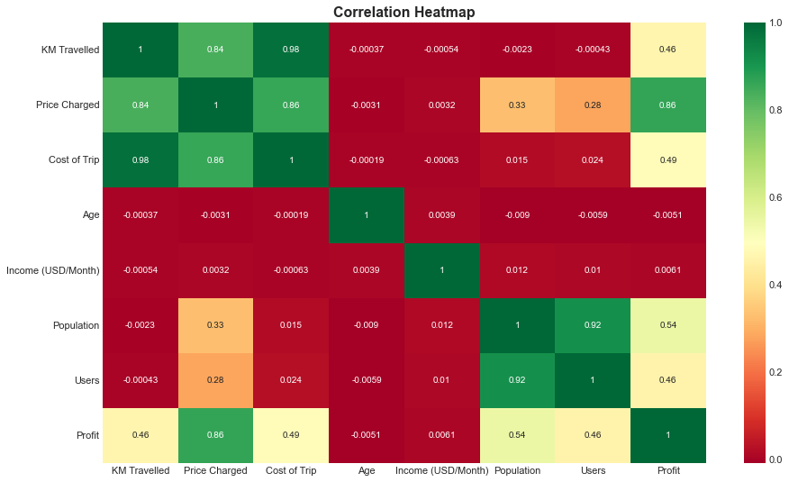
Figure 15: Correlation Matrix
Age and user income have no effect on any of the other attributes.
There is a moderate correlation between Profit and Population, as well as Profit and Users.

Slide 21
Hypothesis Investigation
Hypothesis 1: Does the number of kilometers traveled vary according to the user's income level?
No, According to the correlation matrix, a score of 1.0 is perfectly correlated. But the "KM Traveled" and "Income (USD/Month)" obtained a score of -0.00054. which indicates that they’re weakly negatively correlated. Check out the Figure 15.
Hypothesis 2: Is there a seasonal variation in the number of customers using the cab service?
Yes, We can see a gradual increase in monthly travels for both cab companies beginning in the middle of the year and continuing until the end of the year. Check out the Figure 06.
Hypothesis 3: Is the city with the highest number of cab services and the city with the most cab users relative to their population the same?
No,
Among the cities, New York has the most cab users. However, only 3.59% of their population uses cabs. But cities like San Francisco, Boston, and Washington have the most cab users relative to their populations. More than 30% of the population in these cities uses cabs. Check out the Figure 07 and Figure 08.

Slide 22
Hypothesis 4: Do older people (Above 50) use cabs more often than younger people?
No,
The majority of cab users are between the ages of 20 and 40. The least number of cab users are over 70 years old. Cab users aged between 40 and 60 are evenly distributed. Check out the Figure 04.
Hypothesis 5: Do females use cabs more often than males?
No,
Males prefer cabs over females for both companies. Check out the Figure 05.
Hypothesis 6: Do people prefer to pay with cards rather than cash?
Yes,
For both companies, the majority of cab users prefer to pay with their cards rather than cash. Check out the Figure 03.

Slide 23
Summary & Recommendations
This report presents the Exploratory Data Analysis (EDA) of two cab companies in the United States: Pink Cab and Yellow Cab. All datasets were merged and cleansed before being used to create data visualizations for insight. We discovered that the master data frame contains no null values and duplicate values. Then I went through the EDA process and discovered that,
The ‘Yellow Cab’ appears to make more profits than the 'Pink Cab, owning 89% of both companies' total profit.
Most users prefer to travel in a 'Yellow Cab' rather than a 'Pink Cab’. (may be due to Offers, Advertising and PR)
The ‘Yellow cab’ costs more than the ‘Pink cab.’ This could be due to the facilities, time management, and reputation of the Yellow cab Company.
The 'Yellow Cab' has the highest cab utilization in the United States and a significantly higher profit margin than the 'Pink Cab.’ Means that the business do well at managing their sales costs.
In conclusion, I recommend Yellow Cab would be the better option to invest in.
Other overall cab investment recommendations are mentioned below.

Slide 24
Cab companies should improve their card payment options. Since Users prefer to pay with their cards rather than cash. (like Zettle by PayPal, PayaTaxi)
Cabs should target more younger male users aged 20 to 40 and improve their services accordingly.
Companies should increase the number of cabs near the end of the year as the monthly travel usage gradually increases.
Cab companies should increase their operations in cities such as New York, San Francisco, Chicago, Washington, Boston, and Los Angeles.

Slide 25
Thank You

